Slide 1
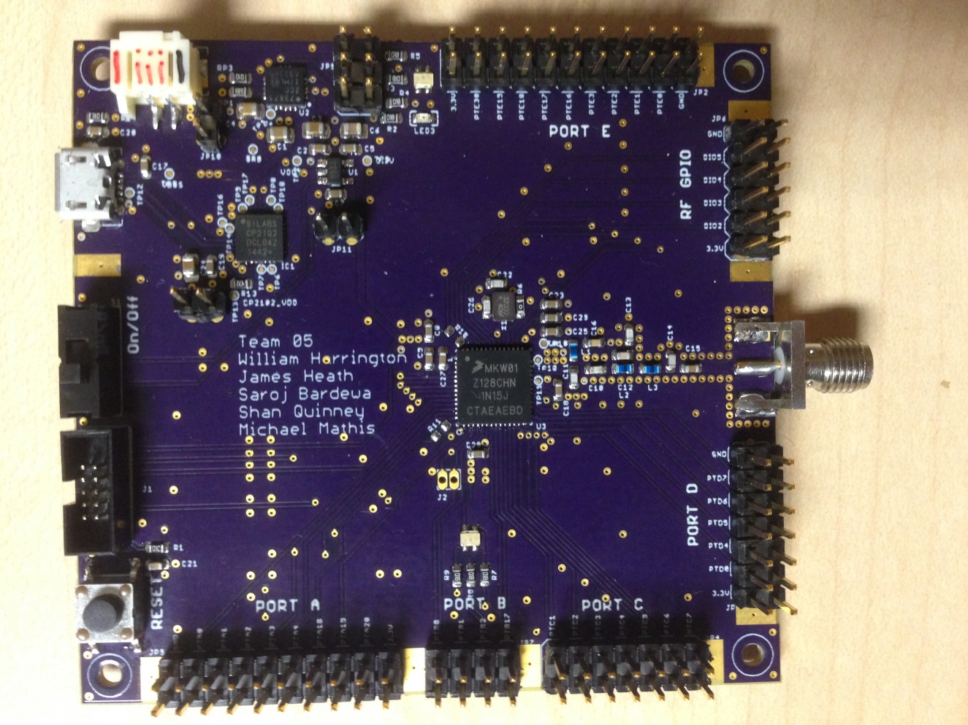

CubeSat C3 Board
(Command, Control and Communication)
Team: T05
William Harrington
James Heath
Shan Quinney
Michael Mathis
Saroj Bardewa
Notes:
<number>

Slide 2
Outline
Notes:
<number>

Slide 3
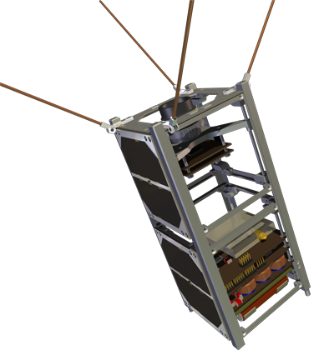
Need
PSAS’s mission is to get a CubeSat into Lower Earth Orbit
Need for a device for command, control and communication (C3) between a CubeSat and a ground station
Board with specific functionalities and broadcast Frequency (436.5 MHz)
Notes:
Problem or Need : What is the problem being solved? Where does it arise?
→ Portland State Aerospace Society has a need of a device that can communication between a CubeSat and a ground Station. The commercial Boards
<number>

Slide 4
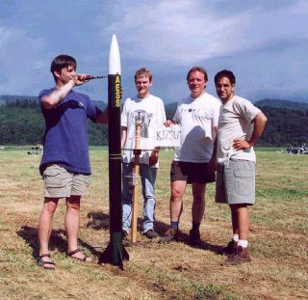
Motivation
Take a small part in PSAS’s CubeSat Mission
Notes:
Motivation: Why is it important? What is the value of a solution?
→Andrew solicited the class to build a system with his specifications
<number>

Slide 5
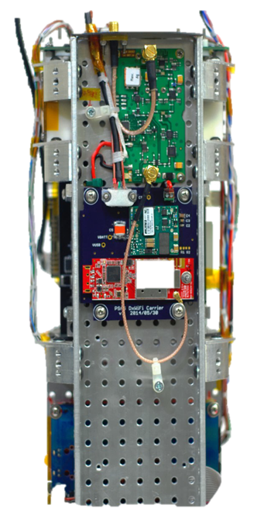
Objective
Build a working prototype to meet the requirements
Notes:
What is the specific objective of this project?A design? Aworking prototype?
<number>

Slide 6
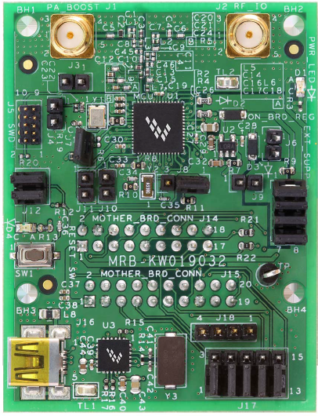
Alternative
Notes:
What other alternatives exists?
→ MRB-KW0x board, but it does not meet the frequency needs and other limitations
<number>

Slide 7
Requirements
Must:
Be a breakout board
Have a transceiver for RF communications
Have a visible indication of communication
Have an antenna capable of 435-438 MHz frequency band transmission
Able to fit within CubeSat form factor (no bigger than (10cm x 10cm x 10cm)
Have access to UART, I2C,SPI,GPIO and ADCs/DACs
Notes:
<number>

Slide 8
Requirements
Should:
Use USB interfacing
Be able to send/receive data packets via RF communication
Be battery powered
If battery powered, utilize USB for recharging
May:
Be capable of long distance communication
Be capable of sending/receiving data packets
Be capable of operation in space temperature range (-30C to 60C)
Notes:
<number>

Slide 9
Approach
User-centered design
The approach was to make a breakout board that was easy to interface and test and capable of RF communication.
Notes:
Brief overview of your approach
<number>

Slide 10
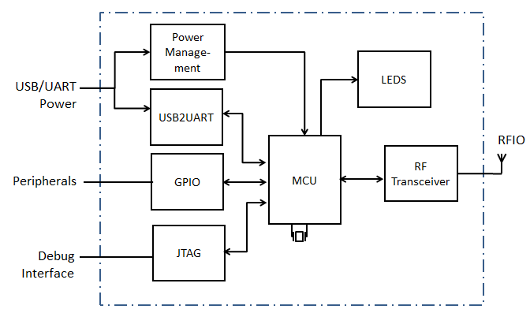
Design
Notes:
May need multiple subAheadings here (e.g. H/W and S/W, or multiple subsystems) Describe design using appropriate methods (e.g. UML models, algorithms) Discuss design alternatives, tradeAoffs, decisions made
<number>

Slide 11
Implementation: Tools
Eagle CAD for PCB layout
OpenOCD for debugging
Multimeter
JTAG connector
Oscilloscope
USB to micro-USB cable
VNA
Notes:
Tools employed (e.g. simulation/modeling tool, PCB layout, IDE, crossAcompilers)
<number>

Slide 12
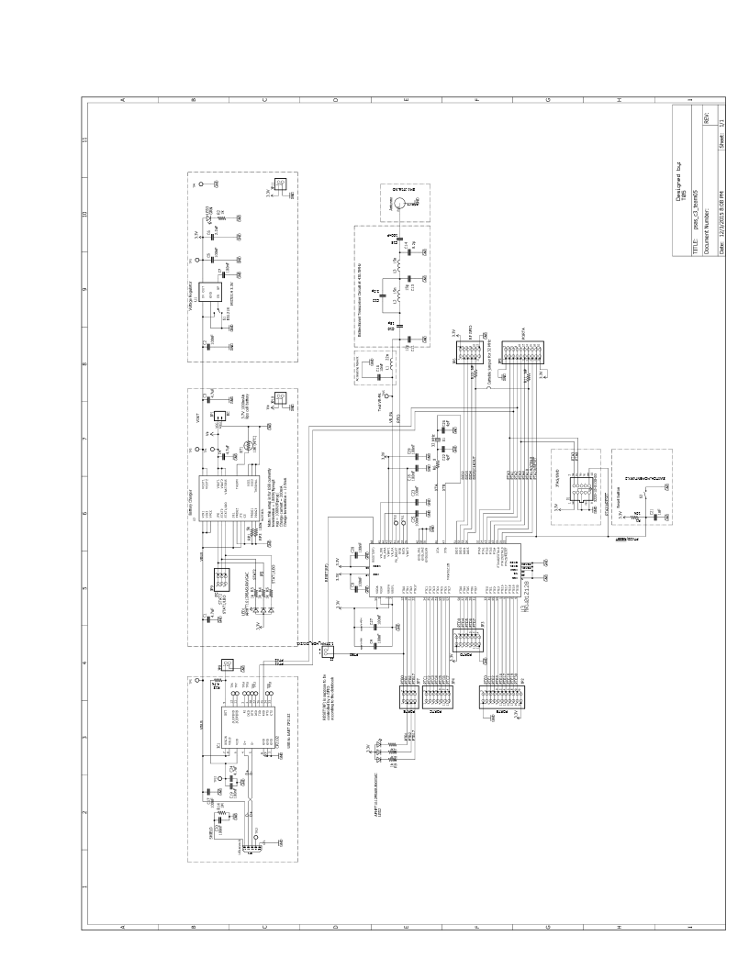
Implementation: Schematics
Notes:
<number>

Slide 13
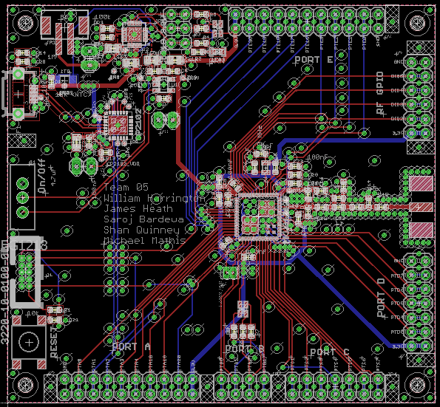
Implementation: Board Layout
Notes:
<number>

Slide 14
Implementation: Built Board
Notes:
<number>

Slide 15
Implementation: Code

Slide 16
IP and Prior Work
MKW01Z128 : Highly-integrated, Cost-effective Single-package Solution for Sub 1 GHz Applications
MKW01xxRM: Sub 1 GHz Low Power Transceiver plus Microcontroller Reference Manual
KW01 Development Hardware: Reference Manual
Notes:
Brief summarize what use you made of prior work or IP including but not limited to ideas, designs, schematics, board layouts, code.
<number>

Slide 17
Testing
System Test
Test Writer: | Shan Quinney
Test Case Name: | RF Front End | Test ID#: | RFFE
Description: | The purpose of this test is to measure the frequency response of the RF filter. | Box Type: | ◻ white box ✓ black box
Tester Information
Name of Tester: |  | Date:
Hardware Version: | Board Rev.1, Filter Rev.1 | Time:
Setup: | Calibrate the VNA to give a 2-port response reading. The frequency range of interest is form 100 MHz to 1 GHz. Attach one end of the SMA cable to the VNA. Attach the other end of the SMA cable to the SMA connector of the board.
Step | Action | Expected Result | Pass | Fail | N/A | Comments
1 | Use the cursor to locate the 436.5 MHz frequency of interest. | The 436.5 MHz frequency falls within the pass band of the filter. Make a comment on the s21 parameter reading. | x |  |  | The frequency fall within the passband of the proto-board filter.
2 | Use a second cursor to locate the 2nd harmonic of the frequency of interest. This should be 873 MHz. | The 873 MHz frequency is attenuated by 40dB bellow the fundamental frequency. Make a comment on the s21 parameter reading. | x |  |  | 873MHz is well below the necessary 40dB.
Overall Test Result: | x
Notes:
Example of System Testing
<number>

Slide 18
Testing
Interface Testing
Test Writer: | Saroj Bardewa
Test Case Name: | JTAG interface | Test ID#: | RFFE
Description: | The purpose of this test is to check that there is connection between JTAG and MCU | Box Type: | ◻ white box ✓ black box
Tester Information
Name of Tester: |  | Date:
Hardware Version: | Board Rev.1, JTAG Rev.1 | Time:
Setup: | Power up the C3 board. Plug in the JTAG cable on the board
Step | Action | Expected Result | Pass | Fail | N/A | Comments
1 | Reset the device | This should bring the board to a known initial state indicated by blinking of tri-colored LEDs. | x |  |  | LEDs blink when code is sent
2 | Probe for the device ID | This should return the device ID to the host computer. | x |  |  | ID was received
Overall Test Result: | x
Notes:
Example of Interface Testing
<number>

Slide 19
Results
Success:
JTAG to MCU test worked
Blinking of a LED
Battery Powered
Battery Charger
Notes:
Results What worked? How well? What didn’t? Why?
<number>

Slide 20
Contributions
Shan Quinney | Michael Mathis
James Heath | Saroj Bardewa
William Harrington
Notes:
What were the contributions of each member (e.g. who did PCB, coding, testing, writing)?
<number>

Slide 21

Acknowledgments
Portland State University
Aerospace Society (PSAS)
Theo Hill of PSAS
Devin ECE411 TA
Notes:
<number>

